Slide 1
Introduction to
Analytics
Notes:
If this PowerPoint presentation contains mathematical equations, you may need to check that your computer has the following installed:
1) Math Type Plugin
2) Math Player (free versions available)
3) NVDA Reader (free versions available)

Slide 2
Learning Objectives
Understand the need for computerized support of managerial decision making
Understand the development of systems for providing decision-making support
Recognize the evolution of such computerized support to the current state of analytics/data science and artificial intelligence.
Describe the business intelligence (BI) methodology and concepts.
Understand the different types of analytics and review selected applications
Understand the basic concepts of artificial intelligence (AI) and see selected applications
Understand the analytics ecosystem to identify various key players and career opportunities
Notes:
Slide 2 is list of textbook LO numbers and statements

Slide 3
Decision Making Process
Understand the decision you have to make.
Collect all the information.
Identify the alternatives.
Evaluate the pros and cons.
Select the best alternative.
Make the decision.
Evaluate the impact of your decision
Notes:
Slide 2 is list of textbook LO numbers and statements

Slide 4
Technologies for Data Analysis & Decision Support
Group communication and collaboration
Data management – managing giant data warehouses and Big Data
Analytical support
Overcoming cognitive limits
Knowledge management
Anywhere, anytime support
Innovation and artificial intelligence
Notes:
Slide 2 is list of textbook LO numbers and statements

Slide 5
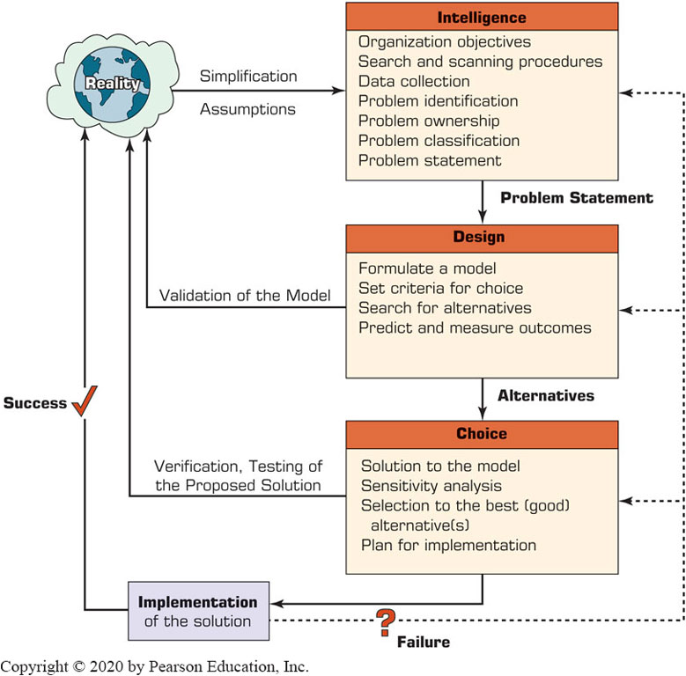
Decision Making Process

Slide 6
Decision Making Processes
Phase 1 - The Intelligence Phase: Problem (or Opportunity) Identification
Data collection
Problem classification
Problem decomposition
Problem ownership

Slide 7
Decision Making Processes
Phase 2 - The Design Phase
Models
Phase 3 - The Choice Phase
Evaluating alternatives
Phase 4 - The Implementation Phase
Implementing the solution
Phase 5 - The Monitoring Phase

Slide 8
The Classical Decision Support System Framework
Degree of structuredness
Structured, unstructured, semi-structured problems
Type of control
Operational, managerial, strategic
The decision Support matrix
Structured decisions
Unstructured decisions
Semi-structured problems

Slide 9
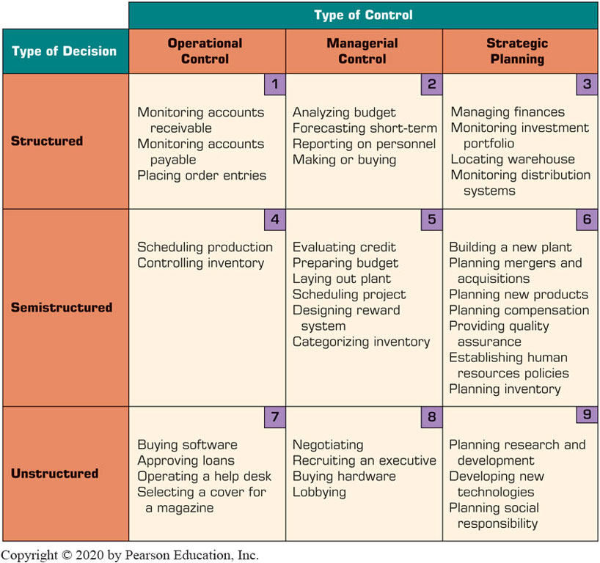
Decision Support Framework

Slide 10
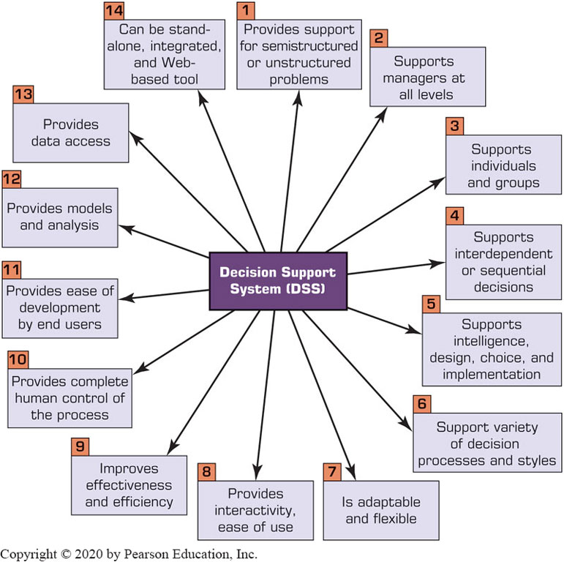
Key Characteristics & Capabilities of Decision Support System

Slide 11
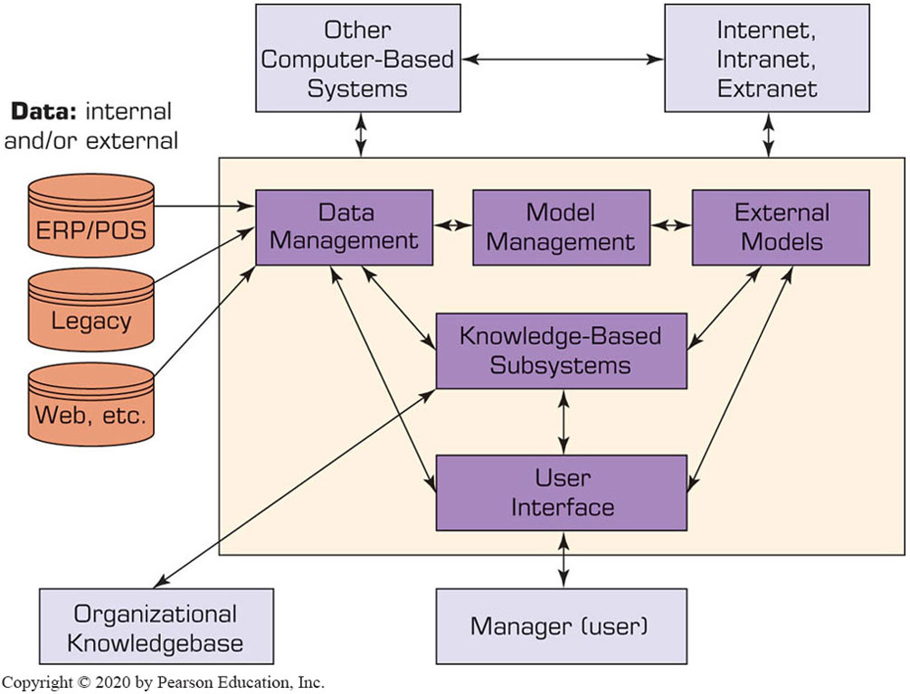
Components of a D S S
The Data Management System
Database management system (D B M S)
Data directory
Query facility

Slide 12
Components of a D S S
The Model Management Subsystem
Model base
Modeling language
Model directory
Model execution, integration, and command processor
The User Interface Subsystem
The Knowledge-base Subsystem

Slide 13
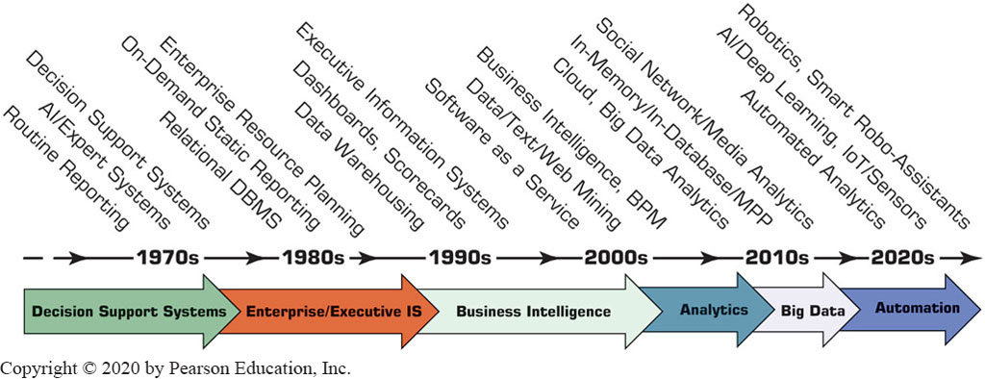
Evolution of Decision Support, Business Intelligence, Analytics, AI

Slide 14
A Framework for Business Intelligence
Definitions of business intelligence (B I)
A brief history of B I
The architecture of B I
Data warehousing (D W) [as a foundation of B I]
Business performance management (B P M)
User interface (dashboard)
Transaction processing versus analytics processing
Appropriate planning and alignment of B I with the business strategy

Slide 15
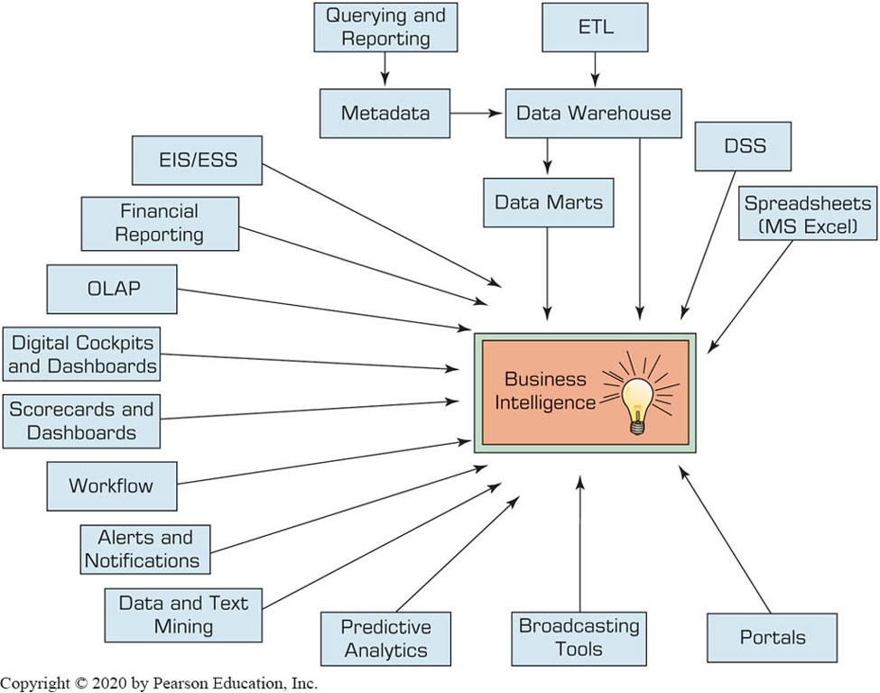
Evolution of Business Intelligence (B I)

Slide 16
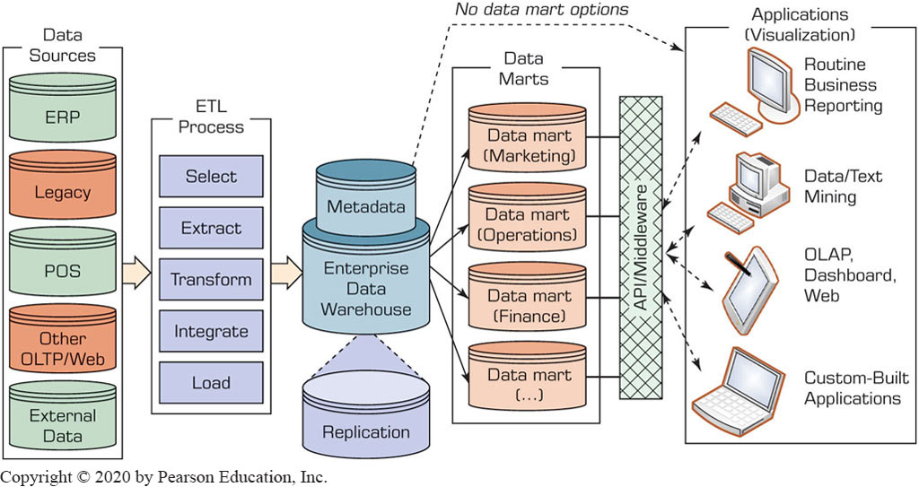
Data Warehouse Framework

Slide 17
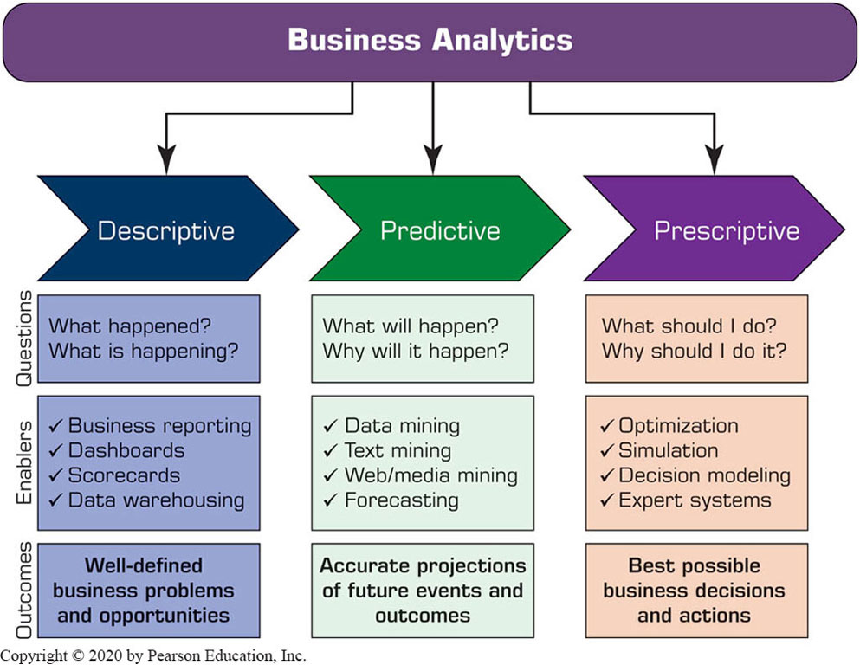
Analytics Overview

Slide 18
Artificial Intelligence Overview
What Is artificial intelligence (A I)?
Technology that can learn to do things better over time.
Technology that can understand human language.
Technology that can answer questions.
The major benefits of A I
Reduction in the cost of performing work.
Work can be performed much faster.
Work is more consistent than human work.
Increased productivity, profitability

Slide 19
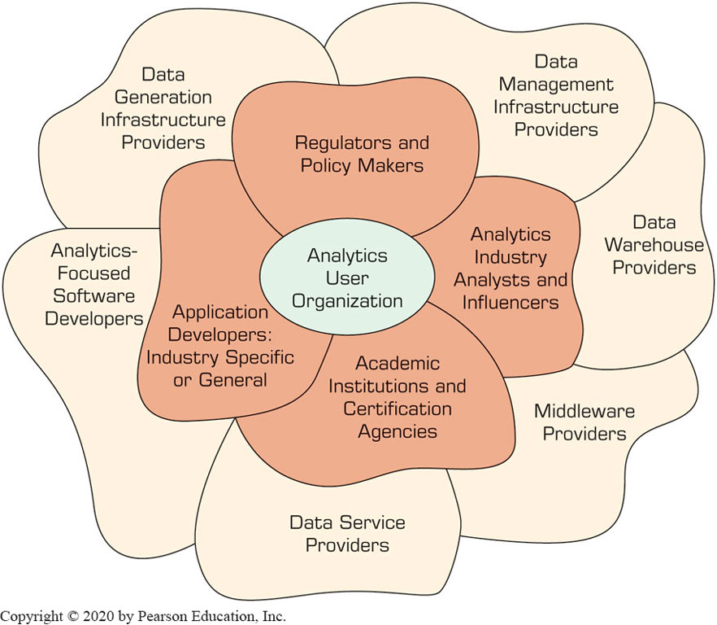
Overview of Analytics Ecosystem

